Slide 1


Optimizing Online Shopping Experience
Data Analysis and Insights

Slide 2
Dashboard Summary
Content:
Purpose of the dashboard: To analyze and optimize online shopping behavior and experience.
Key metrics covered: Customer Lifetime Value, Coupon Usage Rate, Churn Rate, and more.

Slide 3
Customer Lifetime Value (CLV)
A graph showcasing CLV trends.
Insights on the impact of offline and online spending.
Customer Lifetime Value (CLV)
Description: This chart visualizes the lifetime value of customers by comparing their offline and online spending patterns.
Key Insight:
Shows how customers contribute to revenue over time.
Helps identify high-value customers.

Slide 4
Coupon Usage Rate
Pie chart visualization of coupon usage.
Highlight key statistics, such as the percentage of usage by gender or region.
Coupon Usage Rate
Description: A pie chart displaying the percentage of customers who use coupons.
Key Insight:
Highlights the effectiveness of coupons in attracting customers.
Provides insights into customer behavior based on discounts.

Slide 5
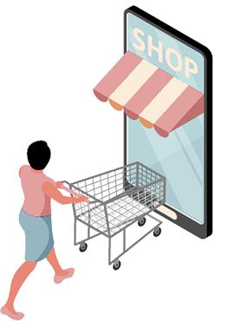
Churn Rate
Line graph tracking churn rate over time.
Key drivers for churn and strategies to address them.
Churn Rate
Description:
Tracks the percentage of customers leaving (churn rate) over different time periods.
Key Insight:
Shows customer retention trends.
Helps identify periods of high churn for corrective actions.

Slide 6

Online vs Offline Revenue Split
Bar chart comparison.
Mention trends and actionable recommendations to balance revenue streams.
Online VS Offline Revenue Split
Description:
Key Insight:
Compares the revenue generated from online and offline channels.
Illustrates the balance between online and offline revenue streams.
Helps in strategizing resource allocation for channels.

Slide 7
Average Order Value (AOV)
Line graph analysis of AOV trends.
Key insights, such as seasonality or customer behavior.
Description: Displays the average value of orders placed by customers over time.
Key Insight:
fluctuations in spending habits.
Helps identify opportunities to increase order values.

Slide 8

Product Category Performance
Bar chart displaying performance by category (e.g., notebooks, mobiles, etc.).
Recommendations for high-performing and low-performing categories.
Product Category Performance
Description:
Key Insight:
Shows customer retention trends.
Helps identify periods of high churn for corrective actions.
Compares revenue performance across different product categories (e.g., notebooks, mobiles).

Slide 9
Gender-Based Revenue Analysis
Horizontal bar chart visualizing revenue distribution.
Mention any disparities and improvement strategies.
Gender-Based Revenue Analysis
Description:
Shows the revenue contribution from male and female customers across online and offline channels.
Key Insight:
Highlights any gender-based preferences or disparities.
Guides targeted marketing campaigns.

Slide 10
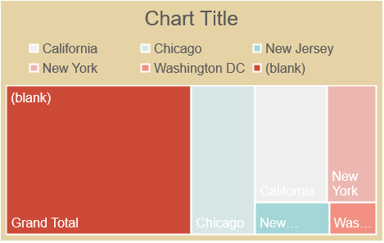
Regional Performance
Highlight revenue performance by regions (e.g., California, Chicago, etc.).
Insights on region-specific campaigns or promotions.
Regional Performance
Description: A heat map showcasing revenue performance by different regions (e.g., California, Chicago, New York).
Key Insight:
Identifies strong and weak regions.
Helps in region-specific decision-making.

Slide 11
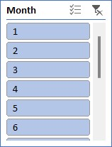
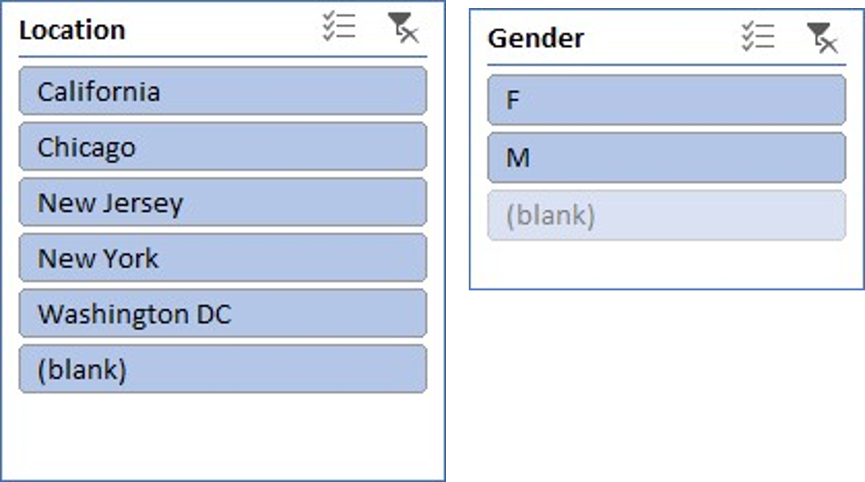
Filters (Slicers)
Description: Interactive slicers allow filtering data by Month, Location, and Gender to dynamically update the dashboard.
Key Insight:
Enhances interactivity and allows focused analysis.

Slide 12

THANK YOU ☺

